Slide 1
What's New in Java 11 : Long-term Support
JAVA 11 INTRODUCTION

Slide 2
Course Overview
Java 11 Introduction
Deprecations & Removals
Language & Library Improvements
Performance & Security Improvements

Slide 3

Follow Along
Download JDK 11
https://www.oracle.com/java/technologies/downloads/#java11
GA: September 25th 2018

Slide 4

Catching Up: Java 9
Module system

Slide 5

Catching Up: Java 10
var

Slide 6
Oracle JDK & OpenJDK
Oracle JDK
OpenJDK

Slide 7

Oracle JDK & OpenJDK
Goal: convergence of Oracle & OpenJDK codebases
Open-source commercial features

Slide 8
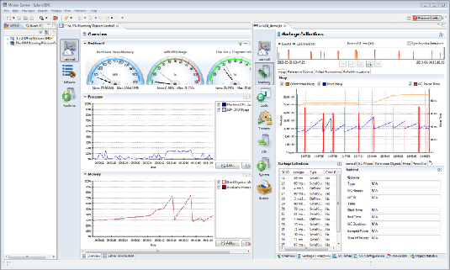
Oracle JDK & OpenJDK
Java Flight Recorder
Always-on, low-overhead data collection framework Bounded circular buﬀer
Java Mission Control

Slide 9
Oracle JDK & OpenJDK
Goal: convergence of Oracle & OpenJDK codebases
Removed:
-XX:+UnlockCommercialFeatures

Slide 10

Licensing
OpenJDK
GPL 2
Oracle JDK
Oracle Binary Code License Agreement
bit.ly/javasubscription

Slide 11
New Java Release Schedule
Java 10 Java 11
Java 31
2018 2019 2020 2021 2022 2023 2024 2025 2026 2027 2028
What about support?

Slide 12
New Java Release Schedule
Java 10
Java 11 LTS
Java 17 LTS
Java 23 LTS
Java 11
2018 2019 2020 2021 2022 2023 2024 2025 2026 2027 2028
Long-term support (LTS) release every 3 years
Oracle JDK only

Slide 13




New Java Release Schedule
Increased frequency Smaller & incremental
Non-LTS releases are not experimental Deprecations/removals between LTS

Slide 14
New Java Release Schedule
OpenJDK:
Adopt release every 6 months
Oracle JDK: Adopt LTS every 3 years
(minimum) with subscription
Others: AdoptOpenJDK, Azul

Slide 15

Launching Single-file Source-code
$ javac Hello.java
Hello.class
$ java Hello
Hello World!
Hello.java

Slide 16
Launching Single-file Source-code
$ java Hello.java Hello World!
Hello.java
--source <version>

Slide 17
Scripting
./listfiles
#!
#!/usr/bin/java --source 11 import java.nio.file.*;
public class ListFiles {
public static void main(String[] args)
throws Exception { Files.walk(Paths.get(args[0]))
.forEach(System.out::println);
}
}
Executable Java script
#!/usr/bin/java --source 11
import java.nio.file.*;
public class ListFiles {
public static void main(String[] args)
throws Exception { Files.walk(Paths.get(args[0]))
.forEach(System.out::println);
}
}
#!/usr/bin/java --source 11
import java.nio.file.*;
public class ListFiles {
public static void main(String[] args)
throws Exception { Files.walk(Paths.get(args[0]))
.forEach(System.out::println);
}
}
shebang

Slide 18
Launch Single-file Source-code
Demo

Slide 19




Oracle JDK & OpenJDK convergence
Summary
Rapid releases: LTS
Launch source-code

